Slide 1
MUNI TEJASREE College name-NRI Institute of Technology
Final Project

Slide 2
PROJECT TITLE
Keylogger and Cyber Security

Slide 3


AGENDA
Problem Statement
Overview of the Project
Identifying the End Users
Solution and value proposition
Wow in Your Solution
ModelingWire Frames
Output
Results
GitHub Link
3/21/2024 Annual Review

Slide 4

PROBLEM STATEMENT
Keyloggers pose a significant threat by covertly capturing sensitive information such as passwords and personal data. This project aims to develop effective methods to detect and mitigate keylogger attacks, enhancing cybersecurity and protecting user privacy.

Slide 5

PROJECT OVERVIEW
Objective: Develop a system to detect and prevent keylogger software, safeguarding sensitive user data and enhancing overall cybersecurity.
Detection Methods: Implement advanced techniques to identify keylogger activity through behavioral analysis and signature-based detection.
Prevention Strategies: Design robust countermeasures to neutralize detected keyloggers and prevent future installations.
User Protection: Ensure user data privacy and integrity by providing real-time alerts and comprehensive reports on keylogger threats.
System Integration: Integrate the solution with existing security infrastructures for seamless operation and improved defense mechanisms.

Slide 6

WHO ARE THE END USERS?
Individual Users: People seeking to protect their personal devices and sensitive information from keylogger attacks.
Businesses and Corporations: Companies needing to secure their corporate data, employee credentials, and proprietary information from cyber threats.
Financial Institutions: Banks and financial organizations aiming to protect customer accounts and transaction data from unauthorized access.
Government Agencies: Public sector entities requiring robust security measures to safeguard classified and sensitive information.
Educational Institutions: Schools, colleges, and universities looking to protect student and faculty data from potential keylogging threats.

Slide 7
YOUR SOLUTION AND ITS VALUE PROPOSITION
Solution: The "Keylogger Detection and Prevention System" is a comprehensive software solution designed to detect and mitigate keylogger threats effectively.
Value Proposition:
Advanced Threat Detection: Utilizes state-of-the-art techniques for early detection of keylogger activity, preventing unauthorized access to sensitive information.
Real-Time Alerts and Reporting: Provides instant alerts and detailed reports on detected keylogger incidents, empowering users to take immediate action to protect their data.
Robust Prevention Measures: Implements proactive measures to neutralize keyloggers and prevent future installations, enhancing overall cybersecurity posture.
User-Friendly Interface: Offers an intuitive interface for easy deployment and management, ensuring accessibility for both individual and organizational users.
Comprehensive Protection: Safeguards personal, corporate, and institutional data from keylogger threats, promoting peace of mind and trust in digital interactions.
This solution aims to deliver proactive defense against keylogger attacks, ensuring data privacy, integrity, and security across various user segments.

Slide 8

THE WOW IN YOUR SOLUTION
AI-Powered Threat Recognition: Harnesses cutting-edge artificial intelligence algorithms to swiftly identify and neutralize even the most sophisticated keyloggers, ensuring unparalleled protection.
Adaptive Behavioral Analysis: Utilizes dynamic behavioral analysis techniques to detect anomalies in typing patterns, effectively differentiating between legitimate and malicious keystroke activities.
Real-Time Adaptive Defense: Employs adaptive defense mechanisms that evolve in response to emerging keylogger tactics, ensuring continuous protection against evolving cyber threats.
Streamlined User Experience: Offers a seamless, user-friendly interface that simplifies setup and management, making advanced cybersecurity accessible to users of all technical backgrounds.
Comprehensive Security Assurance: Provides a holistic approach to cybersecurity by integrating advanced detection, prevention, and response capabilities, delivering unparalleled peace of mind to users and organizations alike.
This solution sets a new standard in keylogger defense, combining cutting-edge technology with user-centric design to deliver exceptional security and reliability.

Slide 9
MODELLING
Install required python libraries in command prompt like,
1. pip install pynput 2. pip install json
Initialization of keylogger : Set up the main GUI window. Initialize global variables for key logging.
Capturing of keystrokes : Start capturing key events when the "Start" button is pressed. Log key press and release events.
Data Logging into text files : update text and Json log files with captured key events.
Stop Logging : Stop capturing key events when the "Stop" button is pressed.

Slide 10
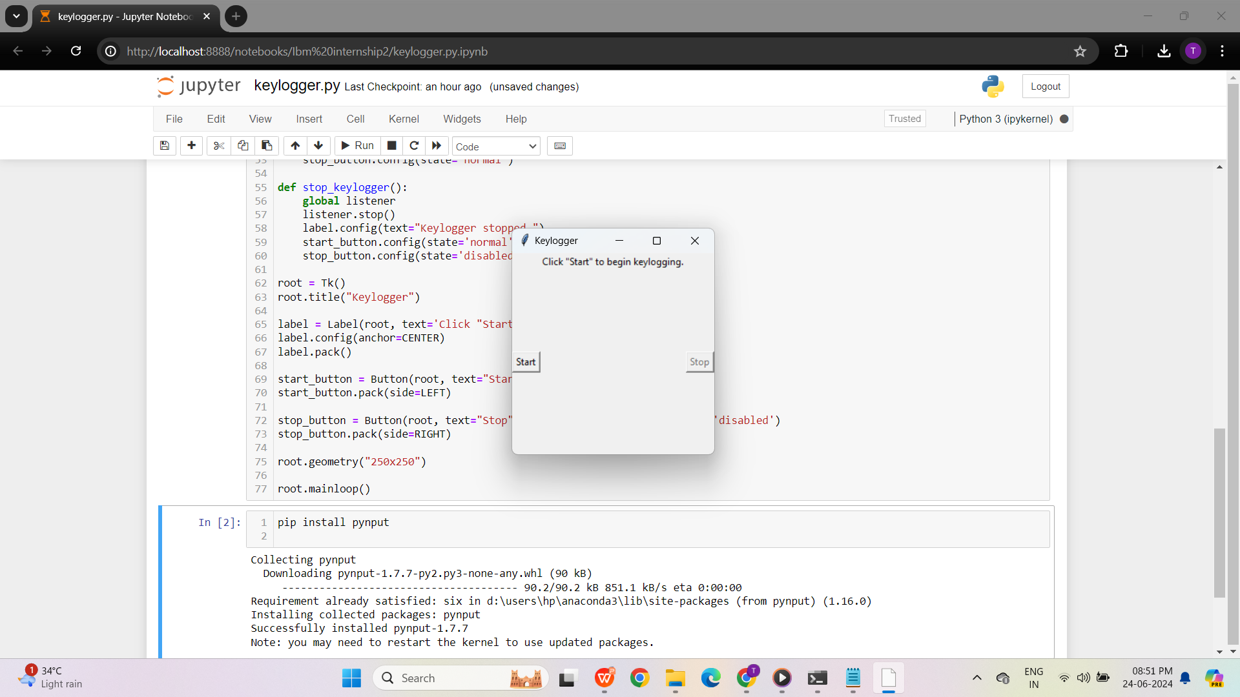

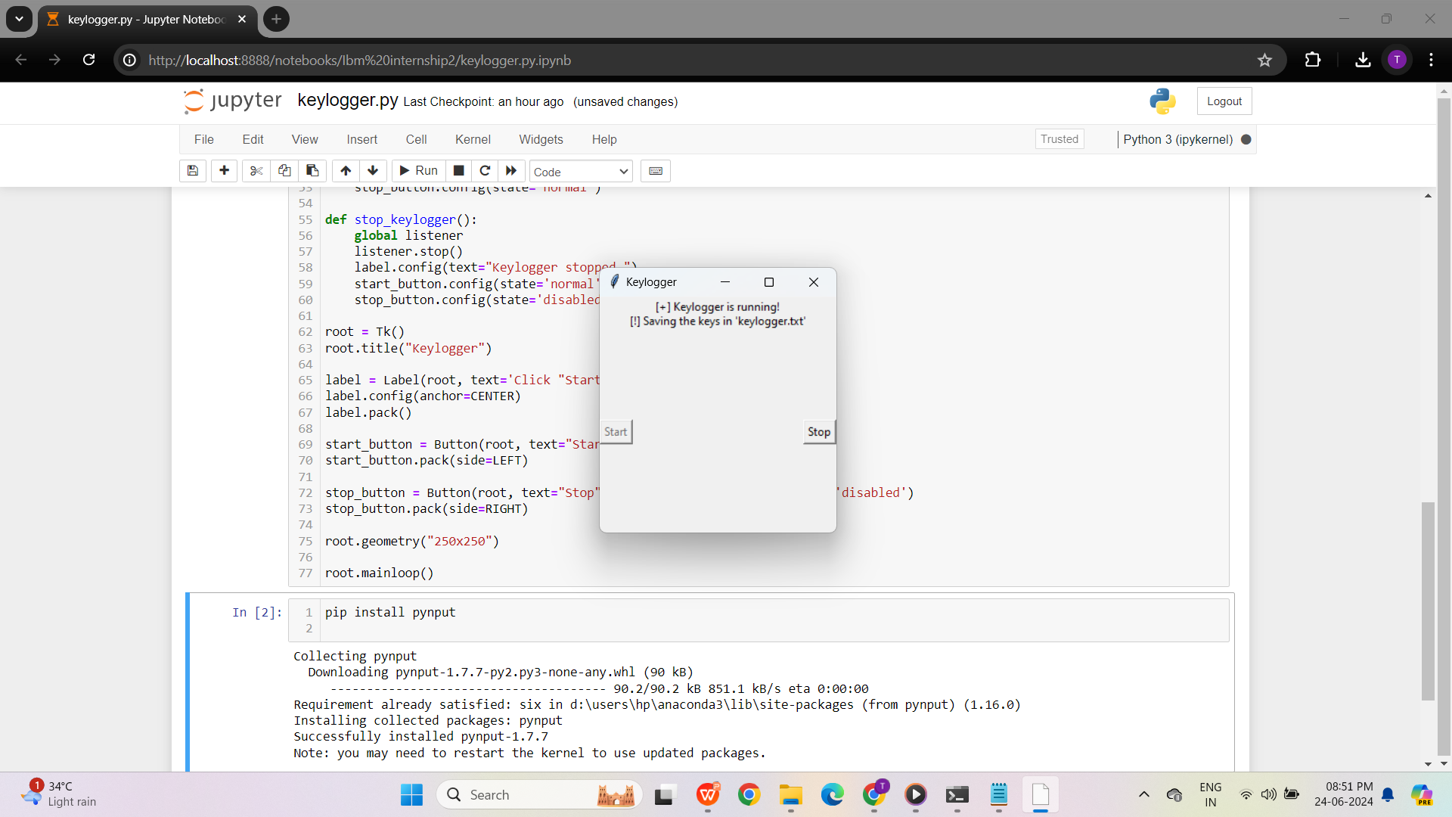
Output
START STOP
________________________

Slide 11
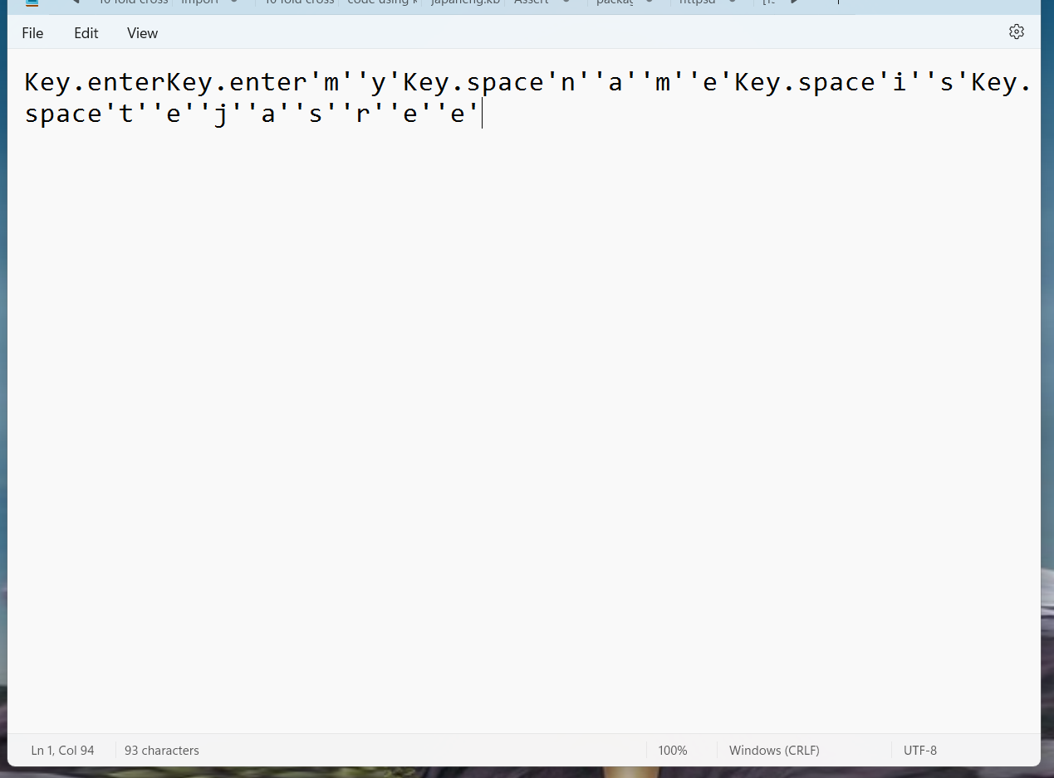
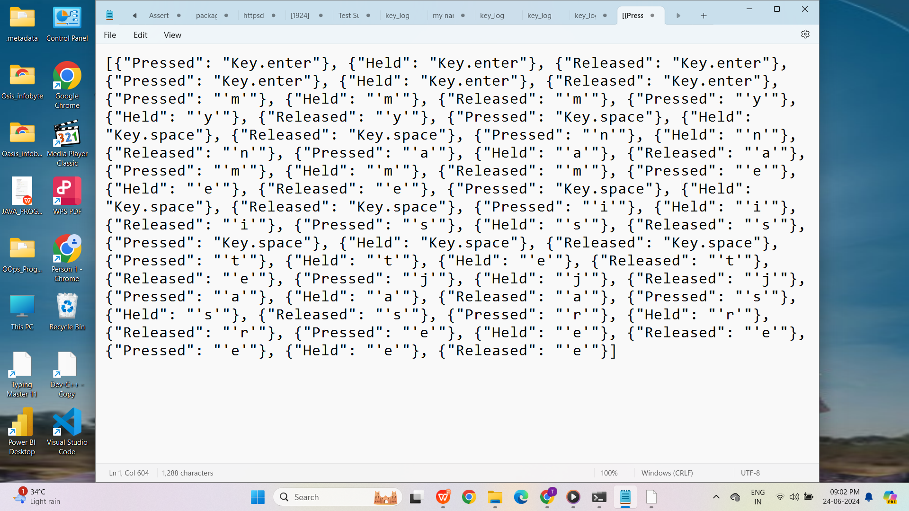
RESULTS
key_log.txt
key_log.json
________________________

Slide 12
GitHub Link
https://github.com/Munitejasree06/Key_logger-cyber-security-project

Slide 13


